Slide 1
WINE PACKAGING SOLUTIONS
Private Label Wine & Spirits

Slide 2
WINE PACKAING SAYS IT ALL
Give your brand the edge at the shelf.
Wine brands all want the same thing: to sell more beverages. We help you achieve this goal by going beyond materials, converting and printing to understand your brands—then build customized solutions that help you succeed.
A key to this success is our ability to identify growth opportunities through primary and secondary research. Our team of marketing and packaging experts uses these tools to gain important market and consumer insights that help you develop new, innovative, secondary packaging approaches that will make your brands value and message.
By focusing on packaging from a branding perspective, we add significantly more value to the finished product—creating secondary packaging that supports your brand’s values, meets consumers’ expectations and helps your brand stand out from competitors.
75%of beverage purchase decisions are made in-aisle

Slide 3
Innovative Package Design
Think bigger, design smarter—sell faster.
Innovative packaging solutions are most effective when they are delivered quickly—giving beverage brands a distinct in-market advantage over their competitors. Typical design, development and implementation processes for packaging can take far too long for brands to wait to see results.
We have an experienced team and professional designers who know and understand the value and importance of brand imaging, design process and cost-effective solutions. Because of this deep experience, we can then commercialize designs into a cost-effective, manufacturable solution that can be implemented quickly and efficiently using our extensive industry knowledge and capabilities.

Slide 4
WINE PACKAGING
PACKAGING TYPE
Glass Bottles
Aluminum Bottles
PET Recycled Bottles
Cans
Pouches
Boxed Wine

Slide 5
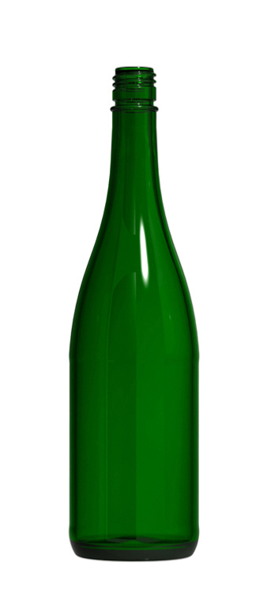
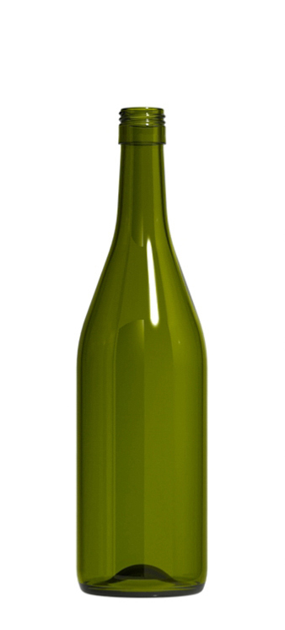
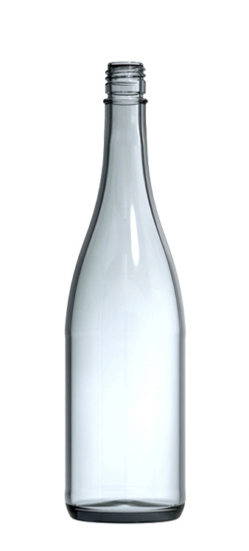
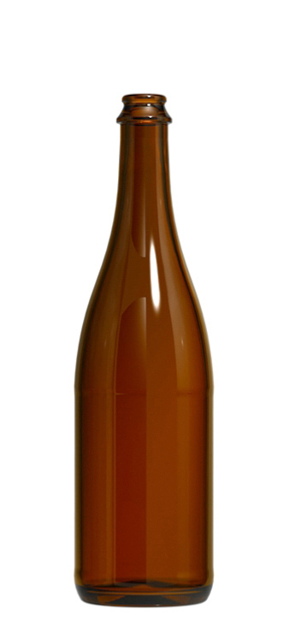
BOTTLE
COLOR
Emerald
Dead leaf
Blue
Flint
Amber

Slide 6
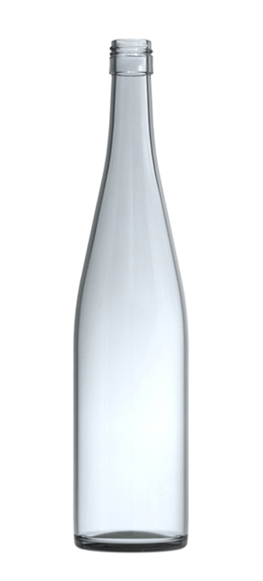
BOTTLE
SHAPE
Bordeaux (Reds)
Burgundy (Whites)
Hock (Sweet)

Slide 7
BOTTLE
PUNT
Flat
Half Punt
Full Punt

Slide 8
BOTTLE
CLOSURE
Cork
Screw Top
Crown
Ropp
Stelvin
Bar Top

Slide 9
BOTTLE
SIZE
187 ml
375 ml
500 ml
750 ml
1 liter
1.5 liter

Slide 10
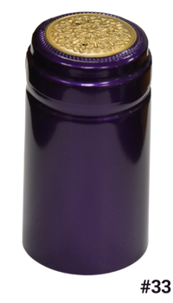
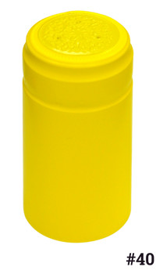
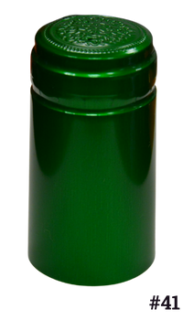
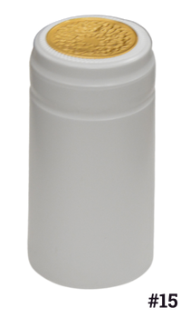
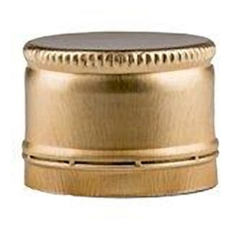
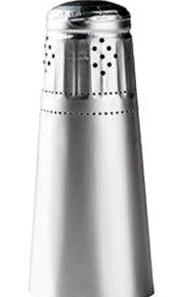
BOTTLES CAPSULES
PVC
STELVIN
OTHERS

